Slide 1
Agriculture in Pakistan
Presents
To:
Dr. Bilal Shah
From:
Munawar Abbas
Faizan Nazari
Talha Ammer
Hamza Rafeeq Azad

Slide 2
Topics:
Introduction
Main Crops
Productions
Rankings
Fruits and Vegetables
Challenges
Water Scarcity
Low Productivity
Inadequate infrastructure
Government initative
Technology and Innovations
Conclusions

Slide 3
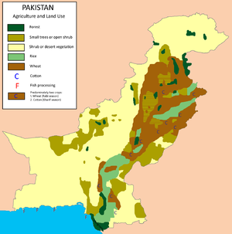
Introduction
Agriculture is a vital sector of Pakistan's economy
It contributes around 24% to its GDP
Employs over 40% of the country's labor force
The sector is also the main source of livelihood for millions of rural households in the country.
Pakistan has a diverse agricultural landscape
with a range of climatic zones and soil types
that allow for the cultivation of various crops.

Slide 4
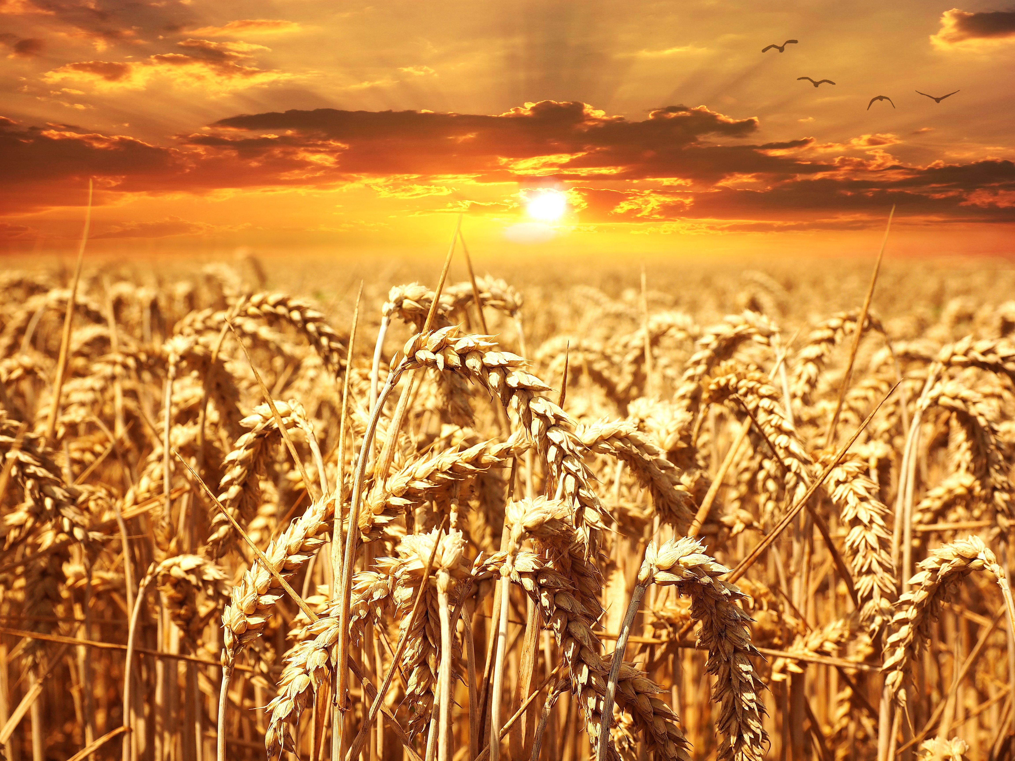
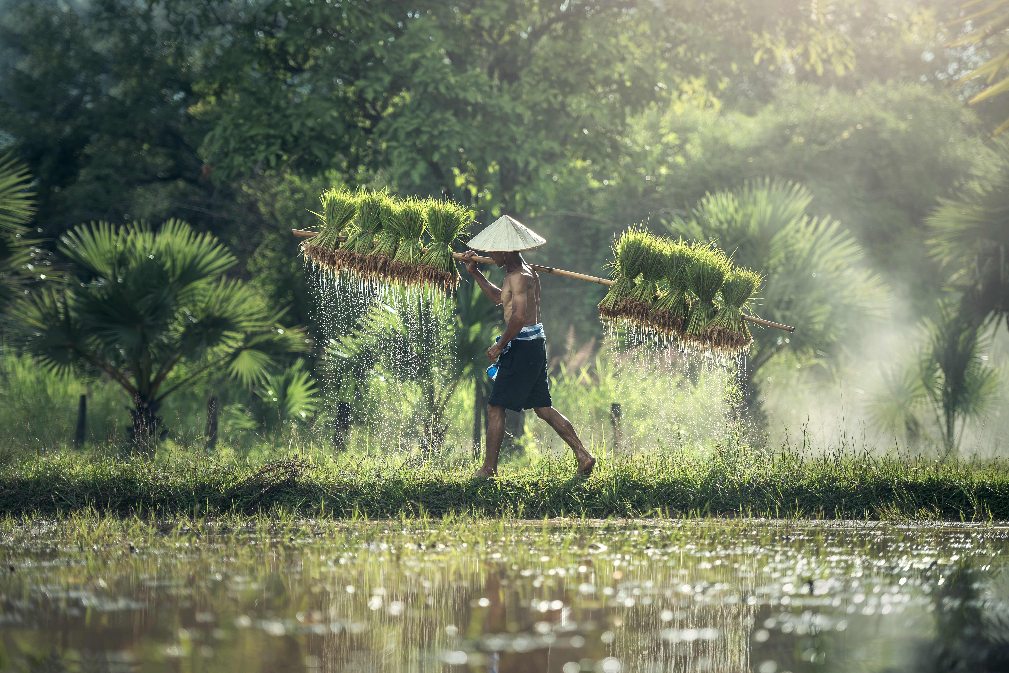

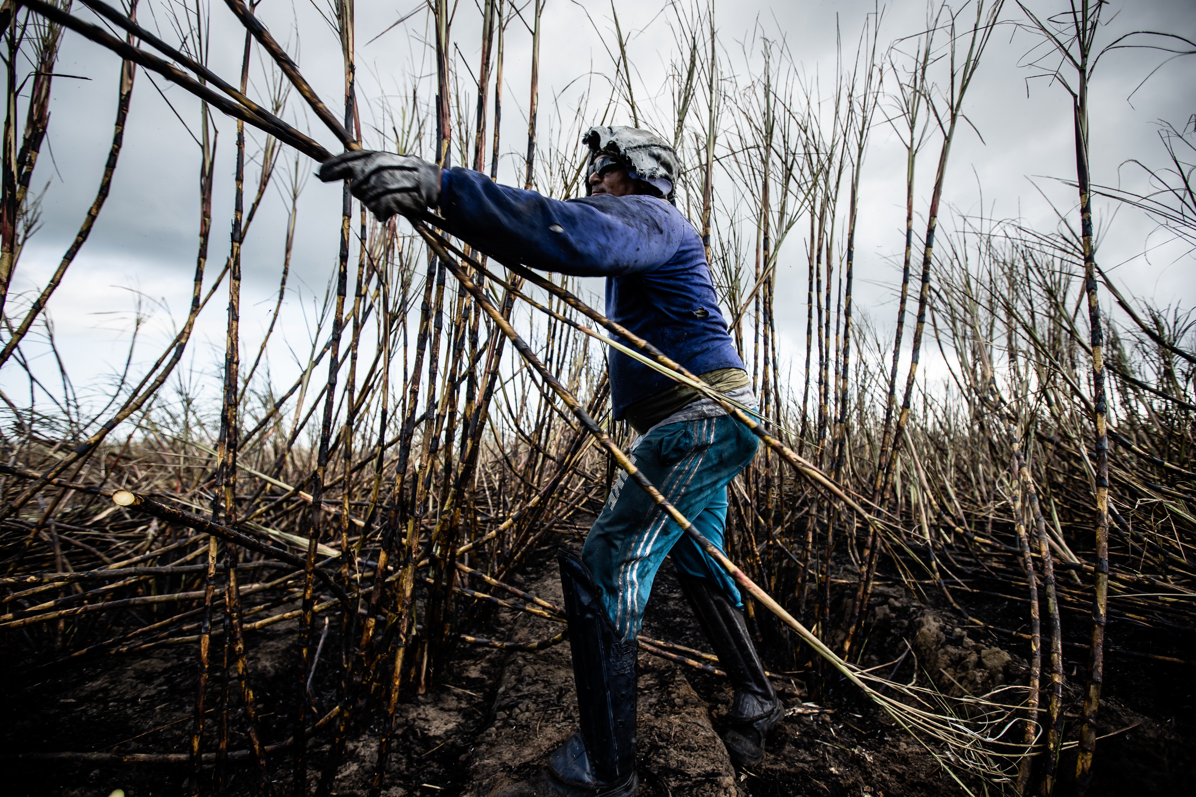
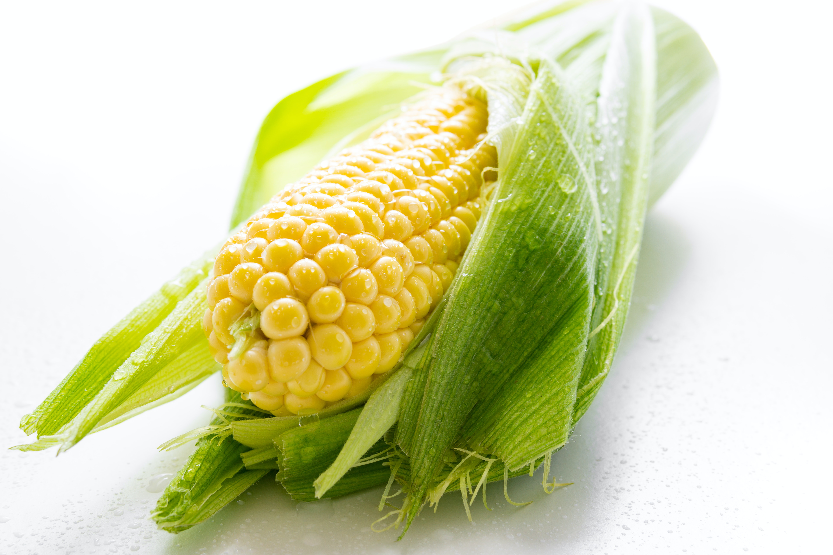
Main Crops
Pakistan's main crops include wheat, rice, cotton, sugarcane, and maize, among others.

Slide 5
Main Crops Continue
1. Wheat
Pakistan is one of the world's largest producers of wheat, and the crop is grown on around 9 million hectares of land, which represents about 41% of the country's total cultivated area.
Wheat is primarily grown in the irrigated plains of Punjab and Sindh provinces.

Slide 6
Main Crops Continue
1. Wheat
Pakistan produces several varieties of wheat, including both hard and soft wheat.
Hard wheat is typically used for bread making, while soft wheat is used for pastry and other baked goods.
Wheat plays a crucial role in Pakistan's food security, as it is a staple food for millions of people.
The crop is also an important export commodity, and Pakistan exports wheat to a range of countries, including Afghanistan, Bangladesh, and Sri Lanka.

Slide 7
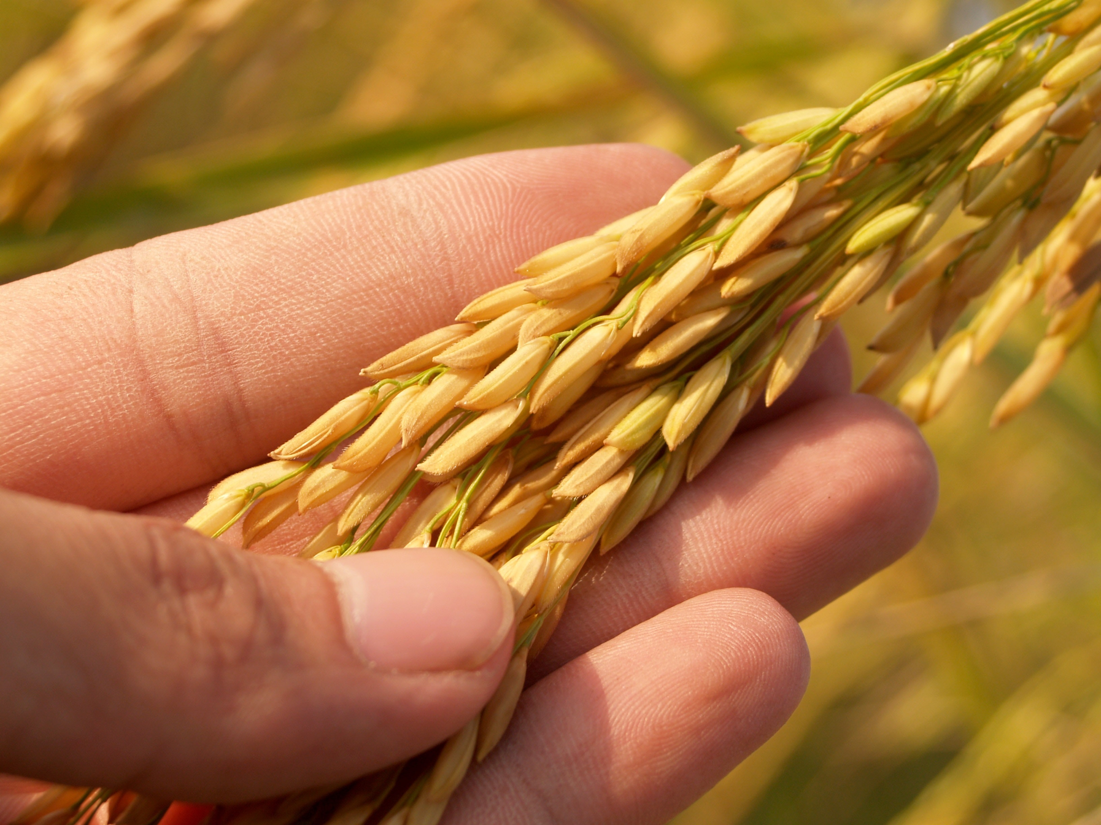
Main Crops Continue
2. Rice
Rice is the second-largest staple food after wheat.
Pakistan is one of the world's largest producers and exporters of rice, more than 10% of the country's total exports.
The crop is grown in all four provinces of the country.

Slide 8
Main Crops Continue
2. Rice
The main rice-growing areas in Pakistan are the Punjab and Sindh provinces, which together account for more than 85% of the country's total rice production.
Pakistan produces several varieties of rice, including Basmati and non-Basmati varieties.

Slide 9

Main Crops Continue
3. Cotton
Pakistan is the world's fifth-largest producer of cotton, and the crop is grown in all four provinces of the country.
The main cotton-growing areas in Pakistan are the Punjab and Sindh provinces, which together account for more than 90% of the country's total cotton production.

Slide 10
Main Crops Continue
3. Cotton
Pakistan produces several varieties of cotton, including long-staple cotton, which is highly valued for its quality and used in the production of premium textiles.

Slide 11
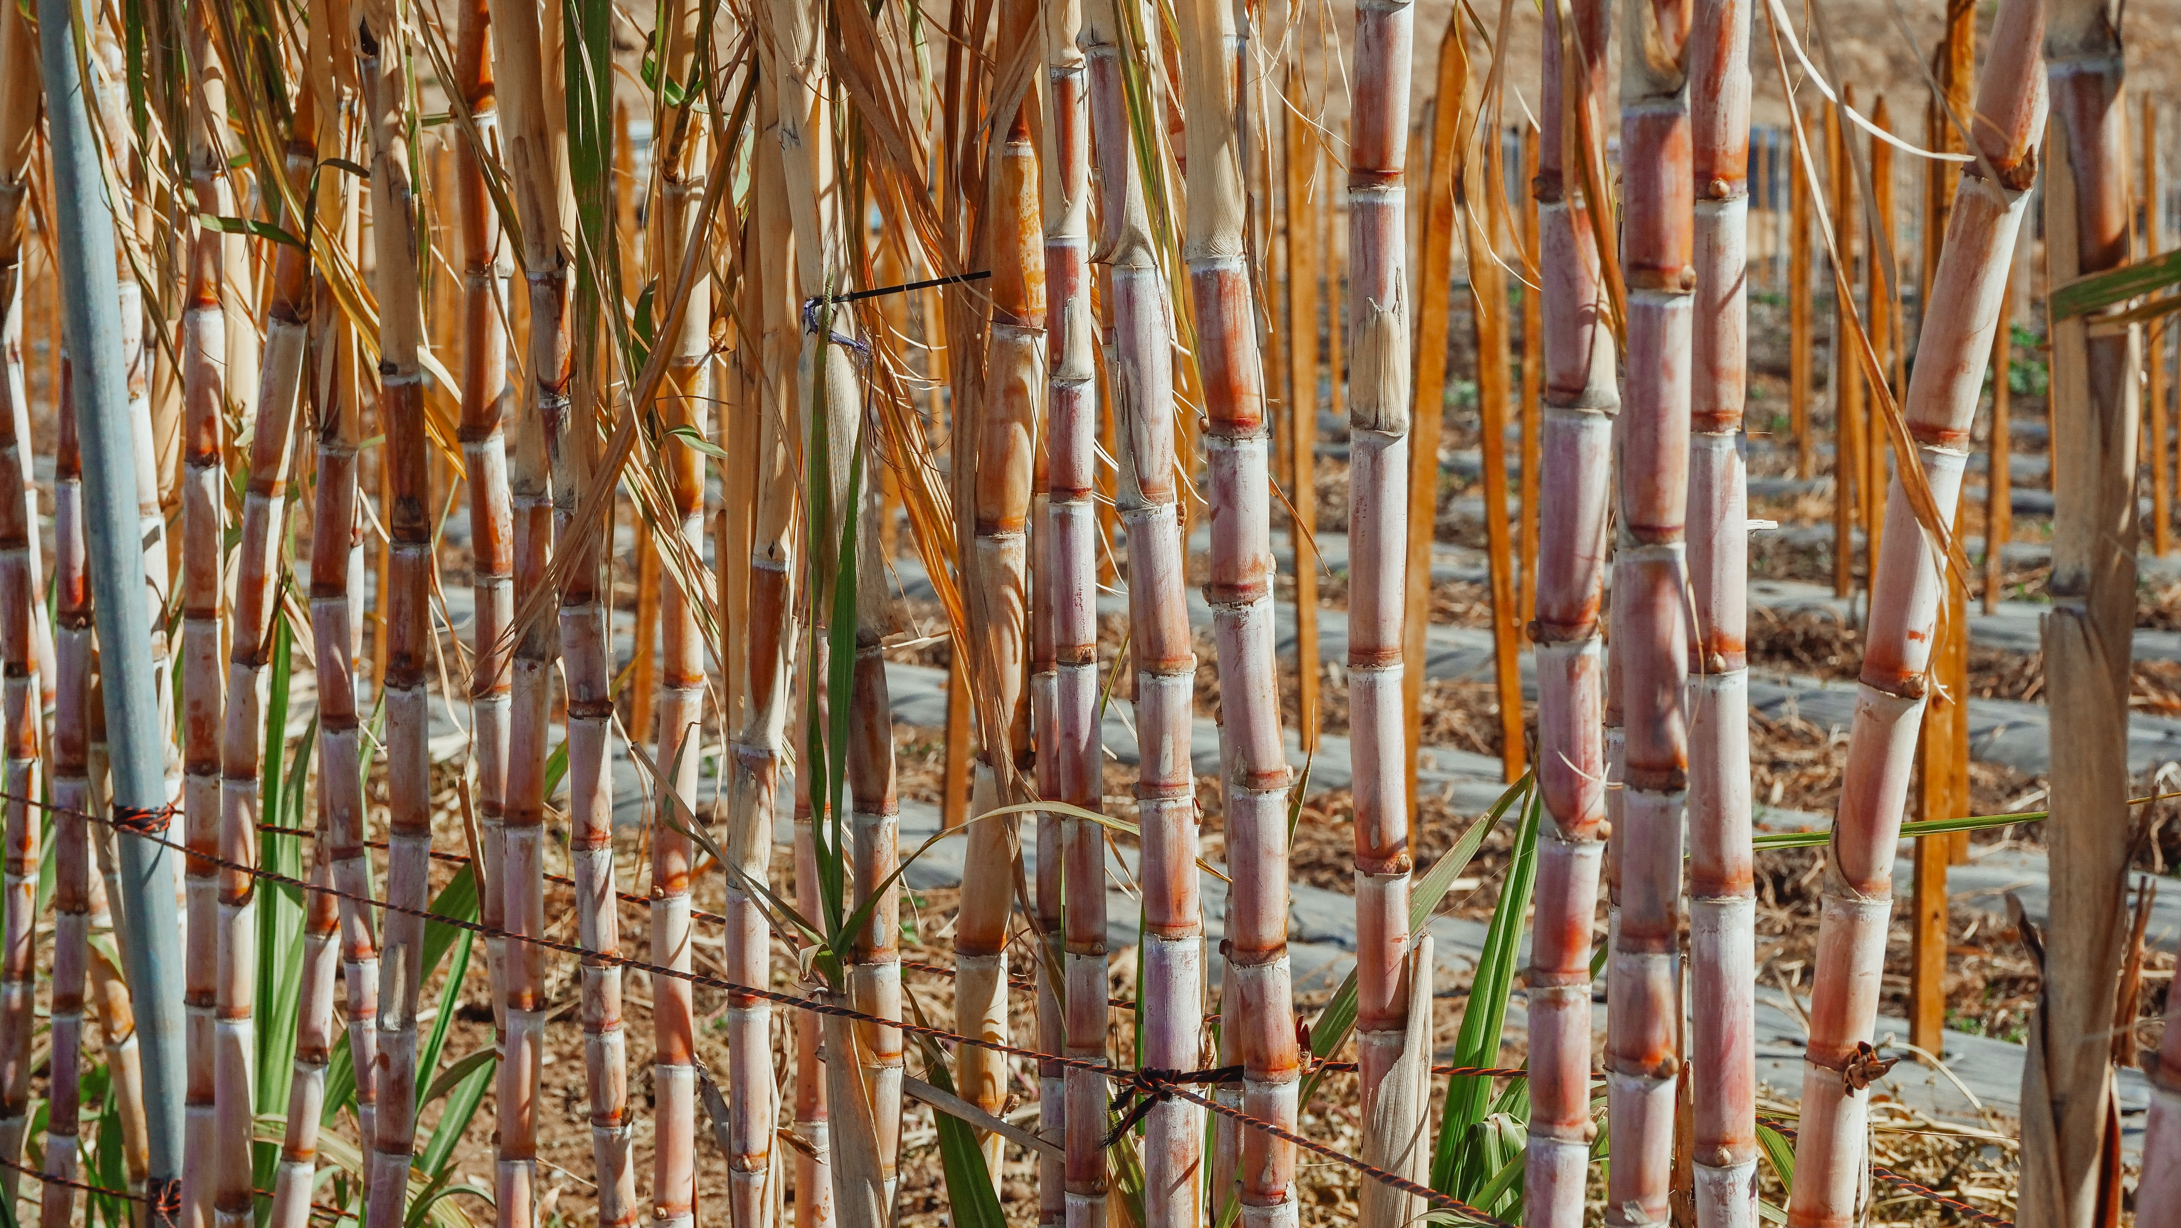
Main Crops Continue
4. Sugar Cane
Sugarcane is an important cash crop in Pakistan, and it is the second-largest crop after cotton in terms of area under cultivation.
The crop is primarily grown in the Punjab and Sindh provinces, which together account for more than 95% of the country's total sugarcane production.

Slide 12
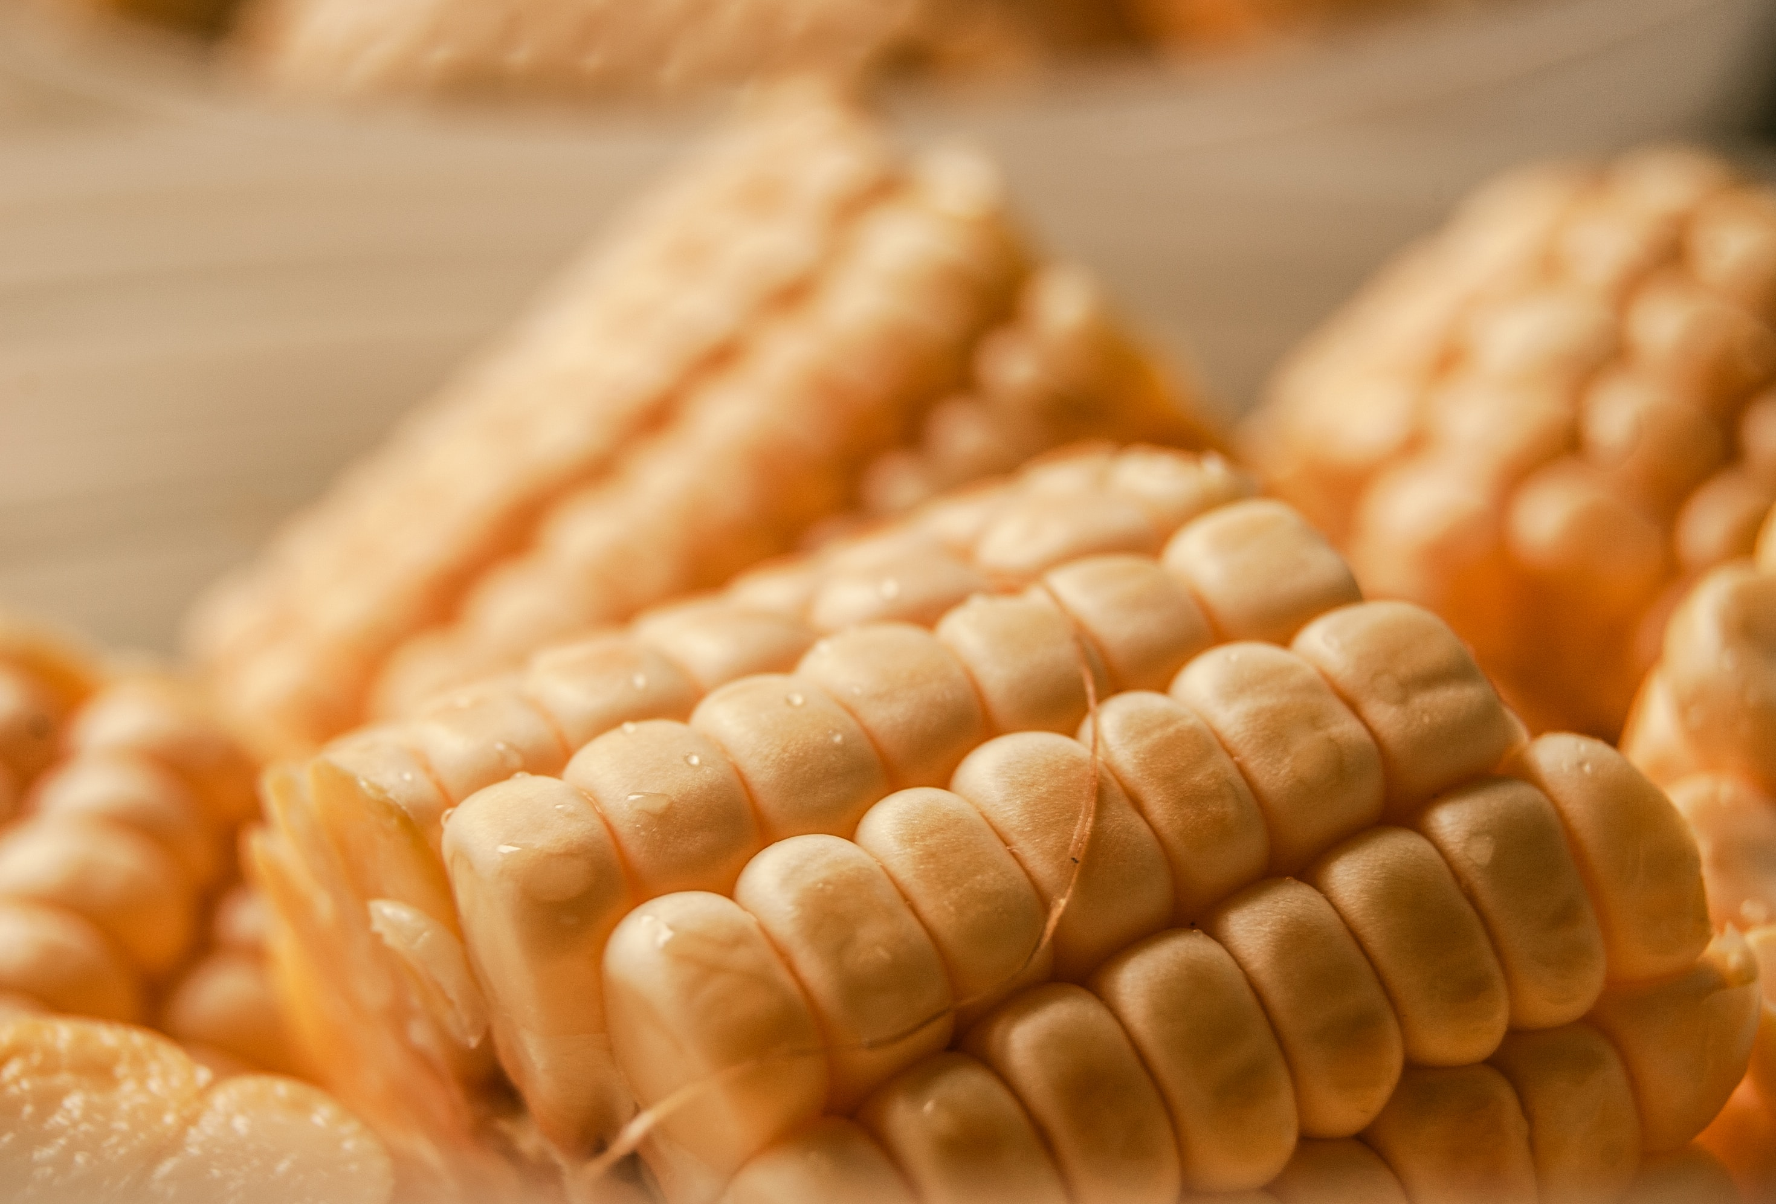
Main Crops Continue
5. Maize
Maize, also known as corn, is an important crop in Pakistan and plays a significant role in the country's agricultural sector.
It is one of the major staple crops, consumed both as food and animal feed. Pakistan is among the top maize-producing countries in the world.
Maize is cultivated all over the Pakistan. The Punjab province is the largest producer of maize in the country.

Slide 13
Productions
Pakistan production (2021):
67.1 million tons of sugarcane (5th largest global producer, behind Brazil, India, China & Thailand);
25.0 million tons of wheat (7th largest producer);
10.8 million tons of rice (10th largest producer);
6.3 million tons of maize (20th largest producer);
4.8 million tons of cotton (5th largest producer);
4.6 million tonnes of potato (18th largest producer);
2.3 million tonnes of mango (including mangosteen & guava) (5th largest global producer, just behind India, China, Thailand & Indonesia);

Slide 14
Productions Continue..
2.1 million tons of onion (6th largest producer);
1.6 million tons of orange (12th largest producer);
593 thousand tons of tangerine;
1,601 thousand tons of tomatoes;
545 thousand tons of apple;
540 thousand tons of watermelon;
501 thousand tons of carrot;
471 thousand tons of date (6th largest global producer);
In addition, smaller production of other agricultural products.

Slide 15
Rankings
Pakistan is one of the world's largest producers and suppliers of food and crops (according to the various global sources).
Chickpea (3rd)
Apricot (6th)
Cotton (5th)
Milk (4th)
Date Palm (5th)
Sugarcane (5th)
Onion (7th)

Slide 16
Rankings Continue..
Kinnow, mandarin oranges, clementine (6th)
Mango (4th)
Wheat (7th)
Rice (11th)
Pakistan ranks 8th globally in farm output, according to the List of countries by GDP sector composition.

Slide 17
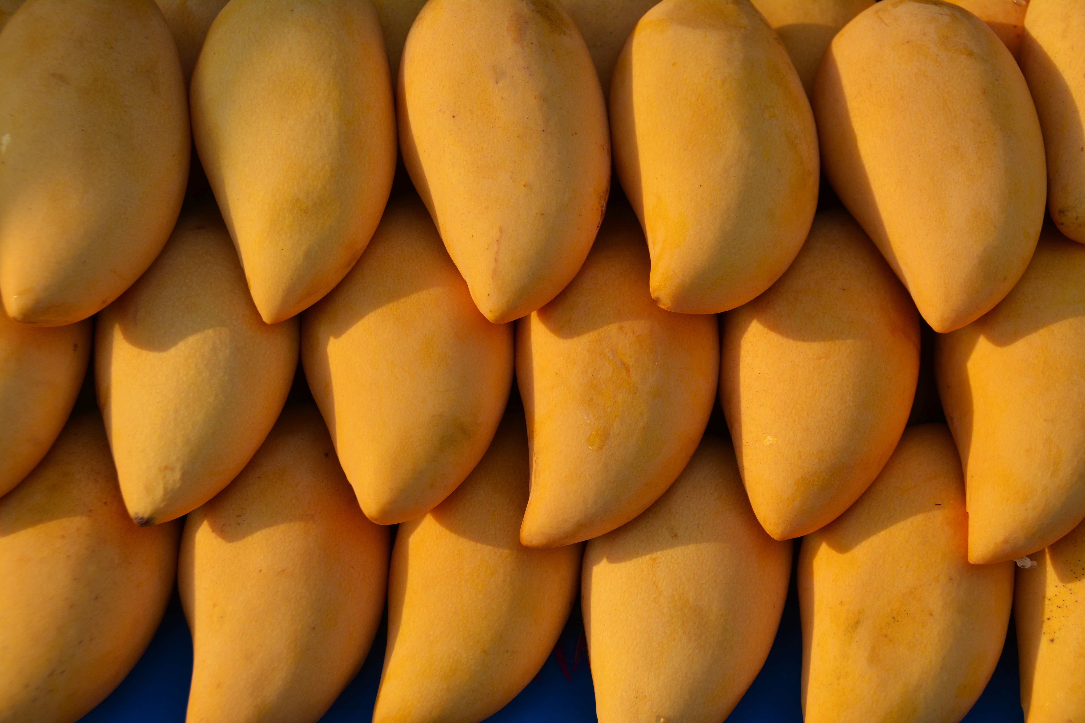


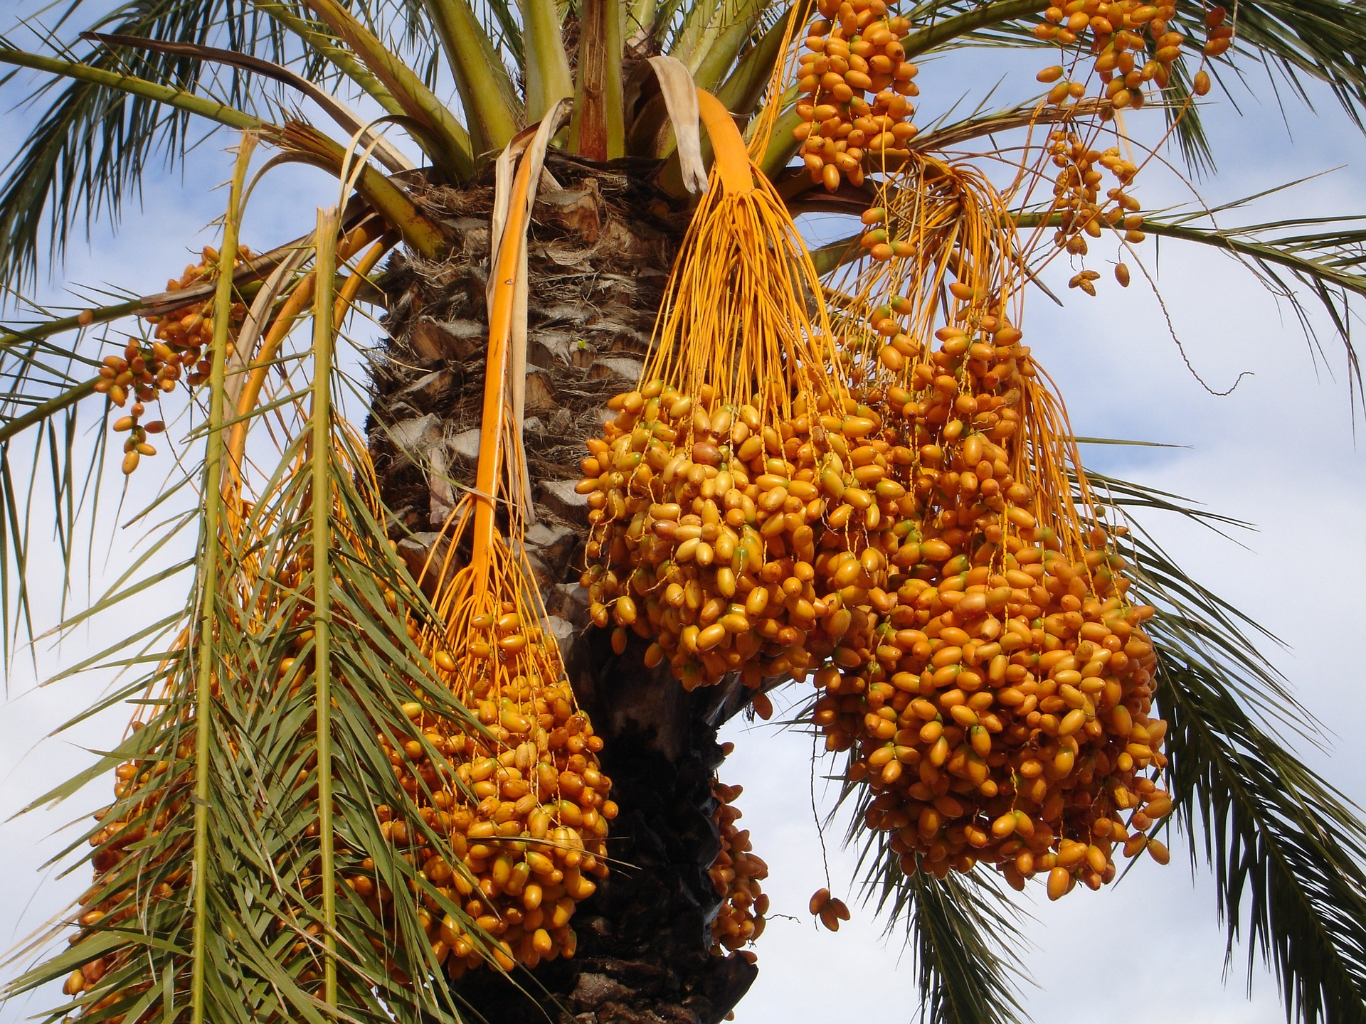
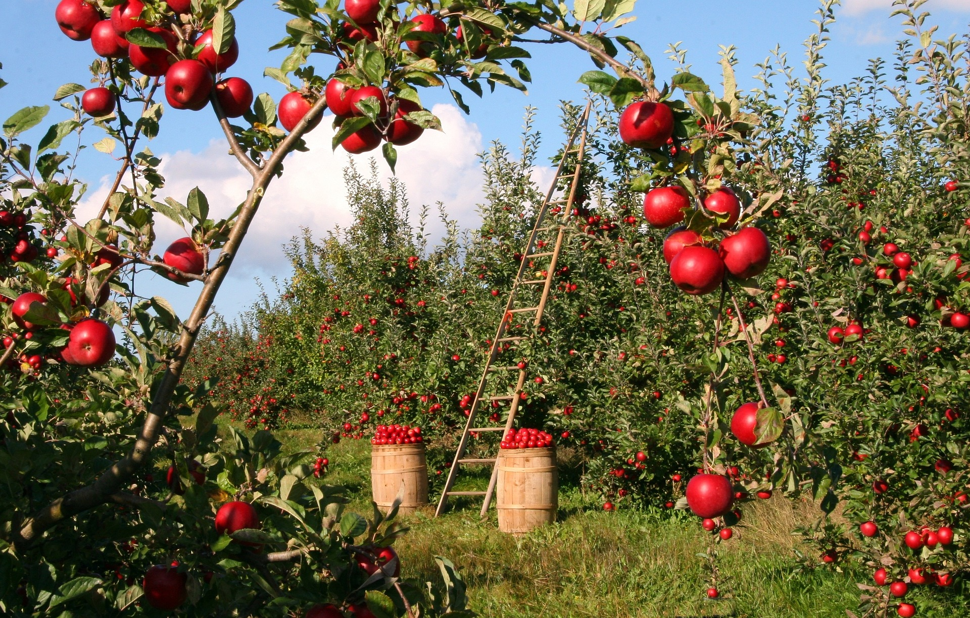
Fruits and Vegetables
Pakistan is also a significant producer of fruits and vegetables.

Slide 18
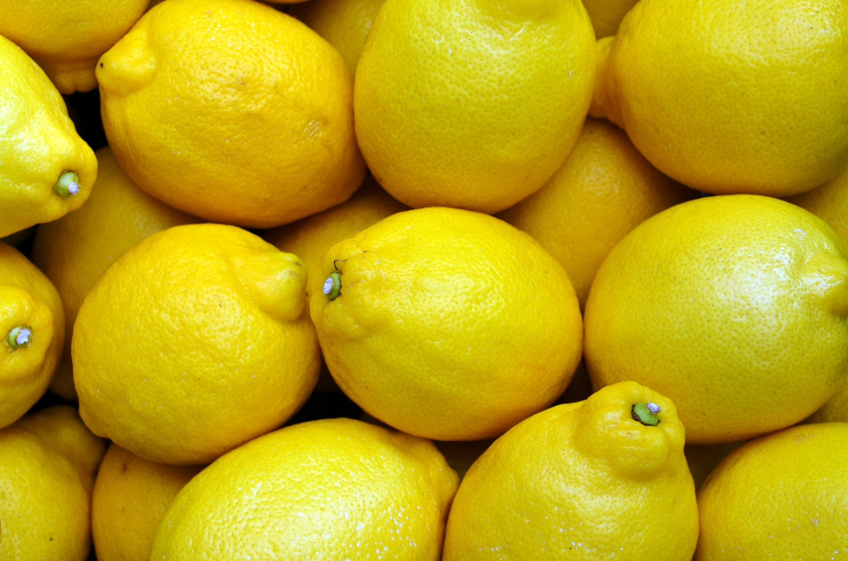
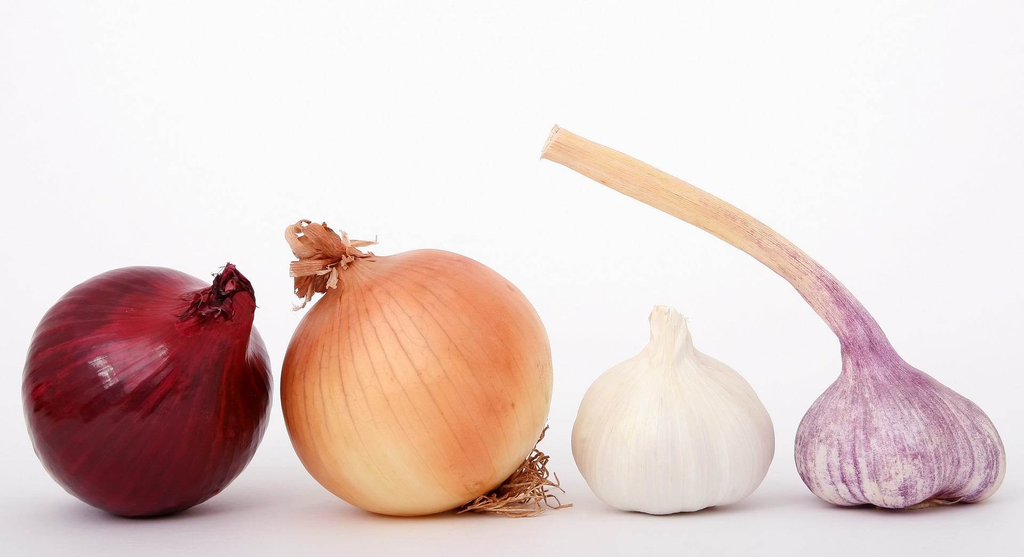
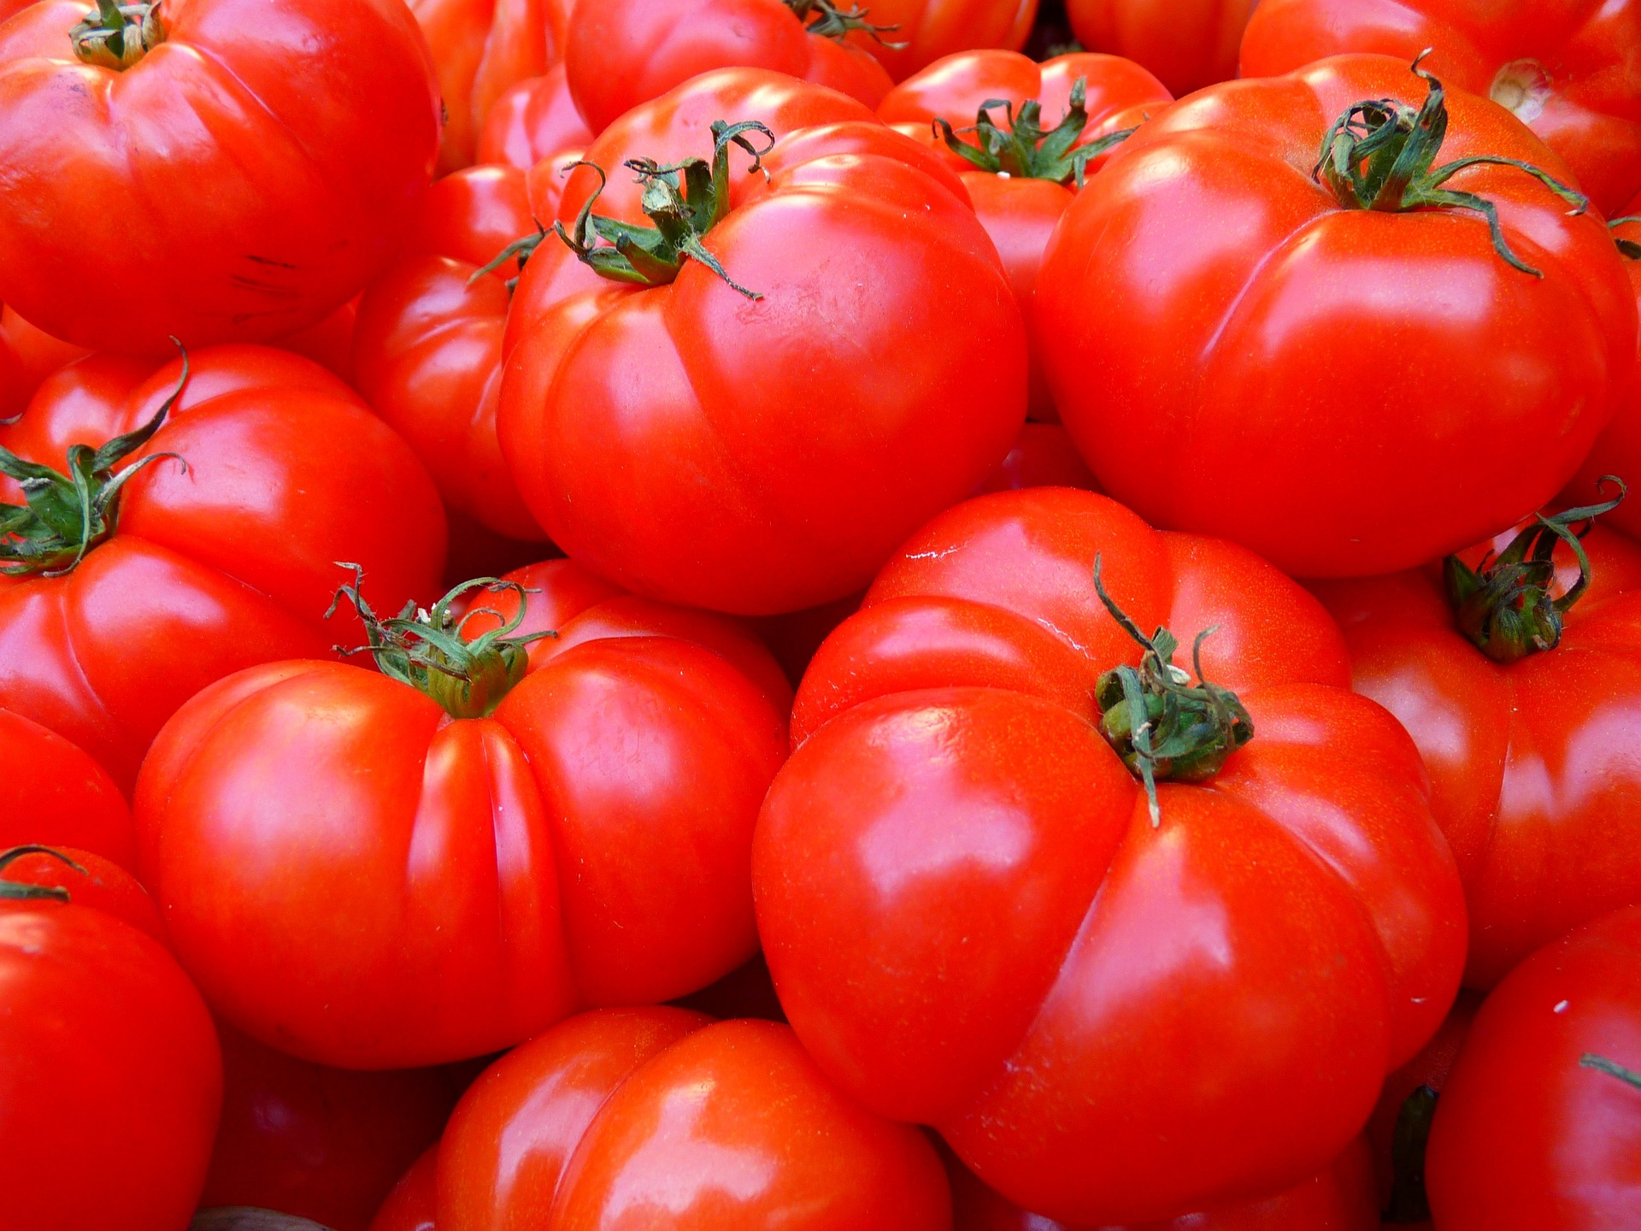
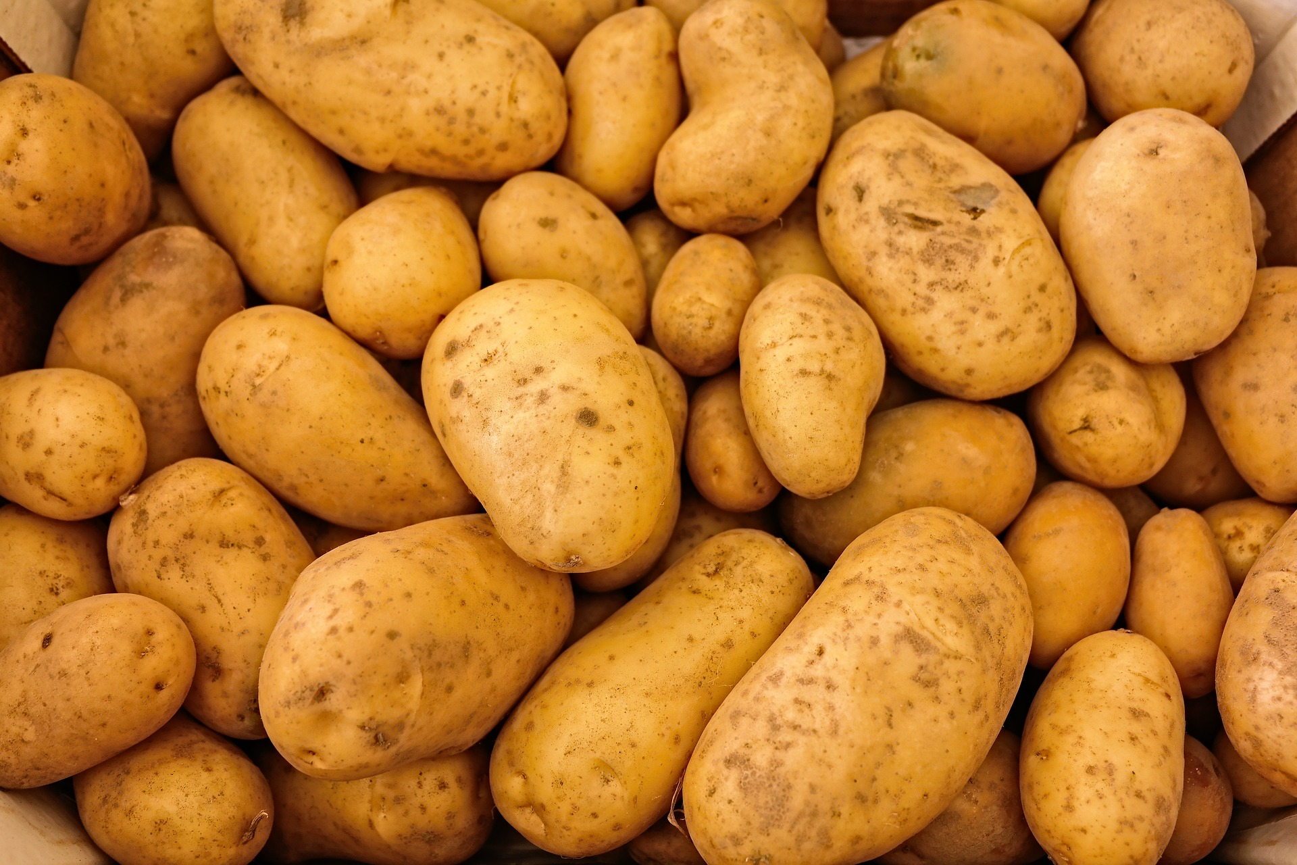
Fruits and Vegetables

Slide 19
Fruits and Vegetables
Pakistan is also a significant producer of fruits and vegetables.
Mangoes are Pakistan's largest fruit export, accounting for over 50% of the country's total fruit exports.
Citrus fruits, such as oranges and lemons, are also widely grown, along with dates, bananas, and apples.
Vegetables, such as tomatoes, onions, and potatoes, are also important crops, providing a source of income for many small farmers.

Slide 20
Challenges
Pakistan's agricultural sector faces several challenges that limit its potential for growth and development.
These challenges include water scarcity, low productivity, and inadequate infrastructure.
Additionally, the sector struggles with pest and disease outbreaks, soil degradation, and climate change, which affect crop yields and farmer livelihoods.

Slide 21
Water Scarcity
Water scarcity is a significant challenge for Pakistan's agricultural sector, as the country is one of the most water-stressed in the world.
The per capita water availability in Pakistan is just 1,017 cubic meters, which is below the threshold for water stress (1,700 cubic meters per capita per year).
The agricultural sector is the largest consumer of water, accounting for around 90% of the total water demand in the country.

Slide 22
Low Productivity
Pakistan's agricultural productivity is low compared to other countries in the region, and yields per hectare are often lower than the global average.
Factors contributing to low productivity include poor quality seeds, inadequate use of fertilizers and pesticides, and limited access to credit and other support services.

Slide 23
Inadequate Infrastructure
Pakistan's agricultural sector also suffers from inadequate infrastructure,
including poor road networks, insufficient storage facilities, and limited access to markets.
These issues often result in high post-harvest losses
and reduced profitability for farmers.

Slide 24
Government Initiatives
The Pakistani government has launched several initiatives to address the challenges facing the agricultural sector and promote its development.
These initiatives include the Agricultural Transformation Plan, which aims to increase productivity, improve value chains, and promote innovation in the sector.
The Kamyab Kisan Program is another government initiative aimed at providing farmers with access to credit, training, and other support services.
The National Agriculture Emergency Program is another initiative that focuses on addressing the impacts of climate change on the sector.

Slide 25
Technology and Innovation
The government is promoting the use of technology and innovation in agriculture to improve productivity and reduce waste.
Precision farming techniques, such as drip irrigation and GPS-guided tractors, can help farmers optimize resource use and improve crop yields.
Improved seed varieties, such as hybrid and genetically modified crops, can also help increase productivity and reduce crop losses due to pests and diseases.
Automated irrigation systems, such as sprinklers and pivot irrigation, can help conserve water

Slide 26
Conclusion
• Agriculture remains a vital sector of Pakistan's economy, despite the challenges it faces.
• With the right policies and investments, the sector has the potential to drive economic growth and improve the livelihoods of millions of farmers across the country.

Slide 27
Any Questions?

